Slide 1

Task 2 BRITISH AIRWAYS MODEL
VETAPALEM PRAVALLIKA

Slide 2
SUMMARY
Data Importing → Scraping reviews using requests and BeautifulSoup
Data Cleaning → Removing unwanted words, punctuation, and short words
Feature Extraction → TF-IDF vectorization
Training Algorithm → K-Means clustering
Model Evaluation → DBI & Silhouette Score
Visualization → Frequent words and clustering distribution

Slide 3
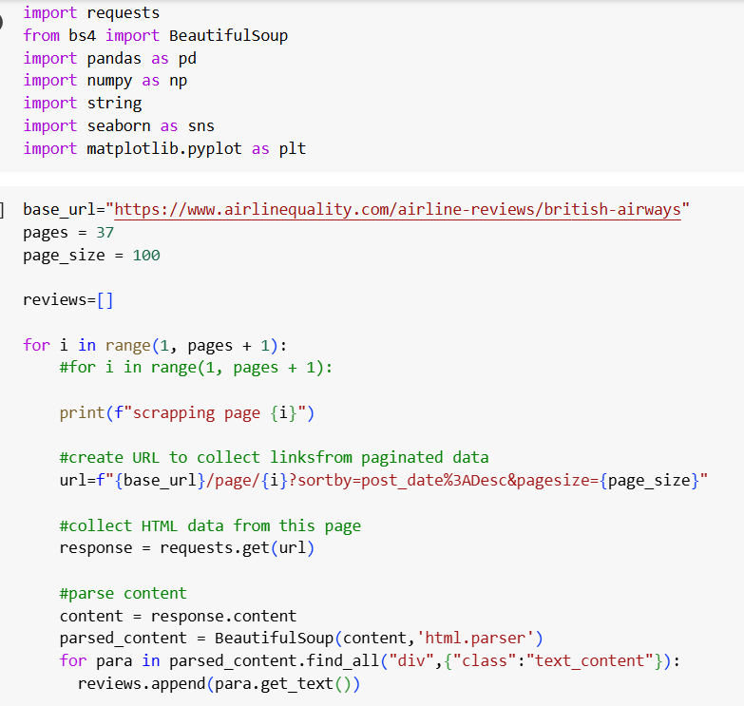

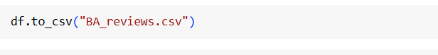

IMPORTING DATA

Slide 4


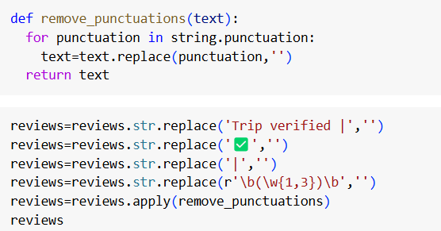
DATA CLEANING DATA ANALYSIS

Slide 5
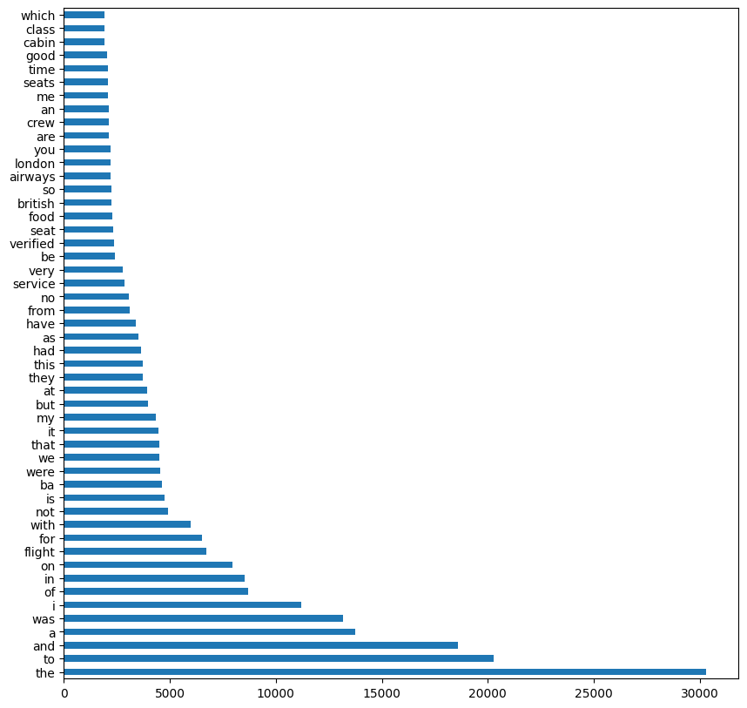

VISUALIZATION

Slide 6
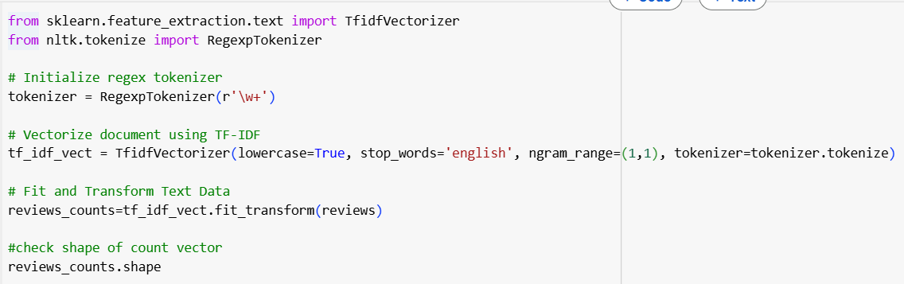
Feature Extraction (TF-IDF)

Slide 7

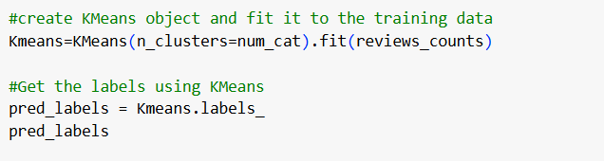
Clustering Algorithm (K-Means)

Slide 8
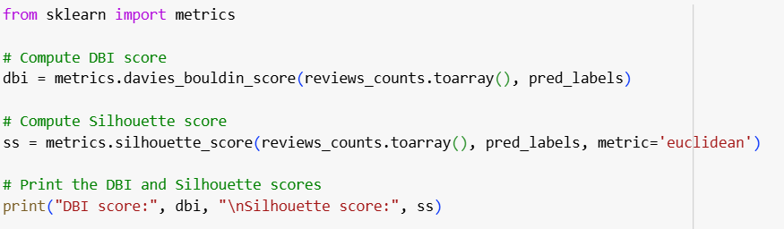
Model Evaluation

Slide 9
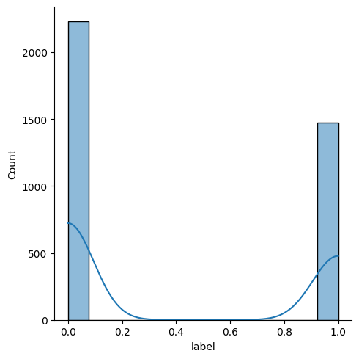

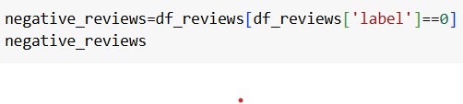
Labeling and Visualizing Clusters

Slide 10
THANK YOU

